Slide 1
SQL Project –
E-commerce Sales Analysis

Slide 2

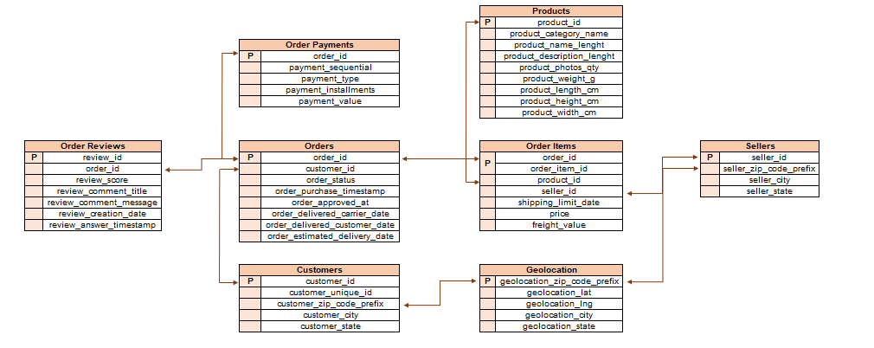
DATA Overview

Slide 3
Project Overview - 1
Your client, a Brazilian E-commerce store, wants you to help them understand how their sales trend across different states over the years and why?.
For this analysis, you are given the data for the time period 2016-2018
a. Create the different metrics like Sales, customer acquisitions, total no. of orders for each Year across the different states they serve.
Does all the metrices show similar trends or is there any disparity amongst each of them?
b. Using the above metrics, identify the top 2 States which show
i. Declining trend over the years
ii. Increasing trend over the years
(Choose yourself the best suited metrics amognst all 3 in point (a) to carry out the analysis)
c. For the States identified above, do the Root Cause analysis for their performance across a variety of metrics.
You can utilize the following metrics and explore a few yourself as well by analyzing the data.
Category level Sales and orders placed, post-order reviews, Seller performance in terms of deliveries, product-level sales & orders placed,
% of orders delivered earlier than the expected date, % of orders delivered later than the expected date, etc.

Slide 4
Project Overview -2
d. Do the above analysis for the top 2 cities which are causing the trend for each of the states identified in point (b)
e. After doing the Root cause analysis, help the client by suggesting ways to improve the performance of the States and the cities
Provide your findings in an excel workbook, plot graphs & create multiple tabs as needed.

